Slide 1
Accelerating Agent-Based Modelling on the Agave Cluster
By Vincent Li

Slide 2
Outline
Intro to Agave
Creating an account
Logging in
Linux commands
Transferring files
Software packages
Running jobs on the cluster
Interactive mode
Slurm Workload Manager / Sbatch scripts
ABM packages on the cluster
NetLogo
FlameGPU
Mesa

Slide 3
Intro to Agave

Slide 4
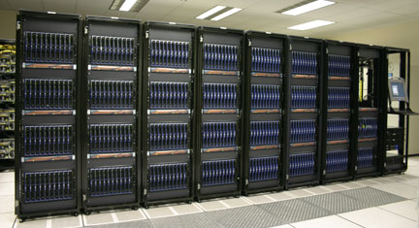
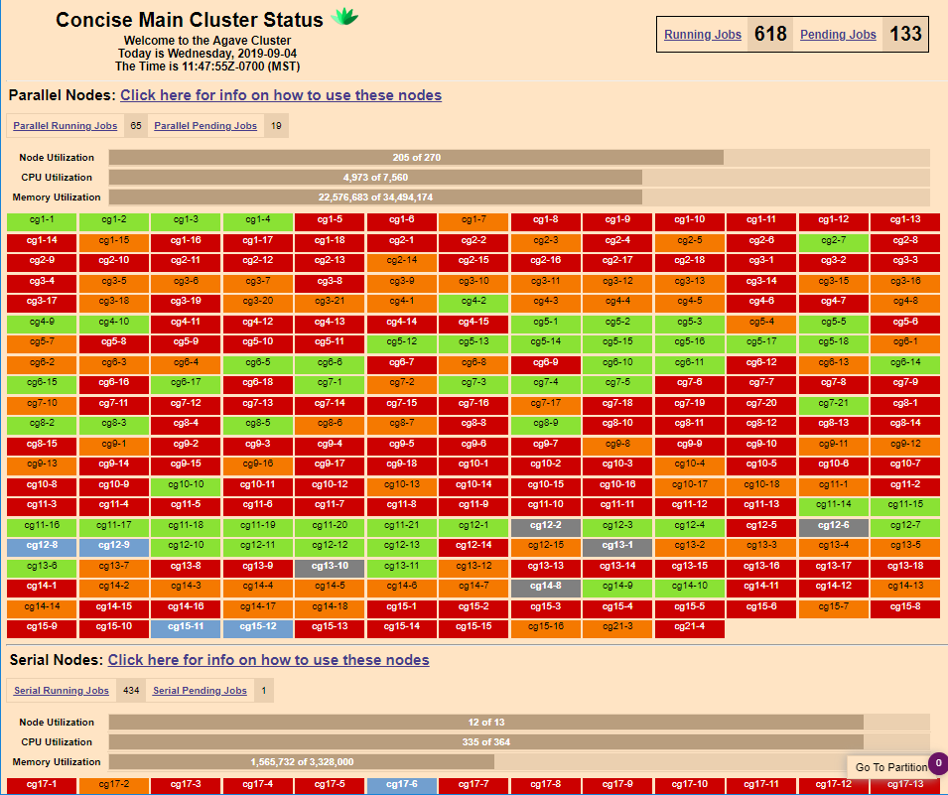
Intro to Agave
ASU’s main high-performance computing (HPC) cluster
Can take advantage of parallel programming and HPC-specific hardware
Collection of university/department/researcher-owned CPU’s and GPU’s
Normal vs wildfire queues
On privately-owned partitions
Non-preemptable vs preemptable
Accessible via the ‘asu’ wifi network
Cisco AnyConnect VPN to access off-campus
sslvpn.asu.edu
lonestar.tacc.utexas.edu

Slide 5


Intro to Agave cont.
Create an account at https://cores.research.asu.edu/research-computing/get-started/create-an-account
Search “asu agave create account” on Google, e.g.
Login
SSH:
Download PuTTY for Windows
Download NoMachine Remote Desktop to access GUI’s from modules (for Windows)
Terminal window for Mac OS or Linux
ssh ASURITE@agave.asu.edu

Slide 6
Intro to Agave cont.
Linux-type OS
Essential commands:
cd <next directory> {move to a subdirectory}
cd .. {move back a directory}
cd ~ {move to the home directory}
mkdir <directory name> {create a new directory}
rm –r <file or folder name> {delete a file or folder}
mv <file name> <directory> {move a file}
mv <file name> <new file name> {rename a file}
cp <file name> <directory> {copy a file to a directory}
cp <file name> <new file name> {copy a file and rename that copy}
ls <-a / -l> <directory> {list entries in directory}
emacs <filename> {open Emacs to create, edit or read a file}
A gazillion more …

Slide 7
Intro to Agave cont.
Transferring files
Mac OS or Linux: secure copy
scp projectfile user1@agave.asu.edu:/home/user1/projectdir
scp –r projectdir user1@agave.asu.edu:/home/user1/projectdir
For large file transfers
rsync –e ssh
rsync –avtr bigfiledir user1@agave.asu.edu:/home/user1/projectdir
Windows
Download Winscp at winscp.net (easiest way)
Drag and drop files and directories between local system and Agave
Has a (finnicky) text editor to edit and view files

Slide 8
Intro to Agave cont.
Loading packages
Load modules to set up PATH and other environmental variables
Set up packages and compilers needed to run the model/simulation/program
module avail <package> {show available versions of a package}
module load <package> <…> {add one or more packages}
module unload <package> {unload a package}
module list {list loaded packages}
module purge {unload all packages}

Slide 9
Running Jobs on the Cluster
Interactive
Inputting instructions through the console. Run command-by-command
Output and error data displayed in console
Job start, completion, failure displayed in console
Can view GUI, viz
Slurm Workload Manager (sbatch script)
Submitting all instructions via a sbatch script
Output and error data placed in files created by Slurm
Email notifications for job start, completion, failure (optional but useful)
Can’t view GUI, viz
Code used for interactive mode and sbatch scripts are essentially the same
Defining partition, wall-time, and queue
Package-specific commands, Linux console commands, and Bash code

Slide 10


Interactive vs Slurm: A Silly Metaphor
Interactive
Instructions given command-by-command by user
Are probably simple enough to remember and type out every time you run them
Can view GUI
Slurm / sbatch scripts
Instructions given all-together through a script via sbatch <sbatchname>.sh
Compute job can be more complicated since you’re not typing them out every time you run it
Can’t view GUI
Get an email notification for job status

Slide 11
Interactive Mode Example
Terminal commands for running a NetLogo model on CPU’s in “headless” mode
[user@agave1:~/NetLogoFiles/Flocking]$ ls
Flocking_1024.out Flocking_256.out Flocking_512.out Flocking.nlogo~
Flocking_2048.out Flocking_4096.out Flocking.nlogo
[userl@agave1:~/NetLogoFiles/Flocking]$ interactive –p debug –n 2 –N 1 –t 0-00:10
Waiting for JOBID 1746533 to start
[user@cg17-8:~/NetLogoFiles/Flocking]$ module purge
[user@cg17-8:~/NetLogoFiles/Flocking]$ module load netlogo/6.0.4
[user@cg17-8:~/NetLogoFiles/Flocking]$ module list
Currently Loaded Modulefiles:
1) java/latest 2) netlogo/6.0.4
[user@cg17-8:~/NetLogoFiles/Flocking]$ netlogo-headless.sh \
> --model Flocking.nlogo \
> --experiment 256 \
> --table results
[user@cg17-8:~/NetLogoFiles/Flocking]$ ls
Flocking_1024.out Flocking_256.out Flocking_512.out Flocking.nlogo~
Flocking_2048.out Flocking_4096.out Flocking.nlogo results
[user@cg17-8:~/NetLogoFiles/Flocking]$ exit
exit
[screen is terminating]
Connection to cg17-8.agave.rc.asu.edu closed.
[user@agave1:~/NetLogoFiles/Flocking]$

Slide 12
Sbatch Script Example
Sbatch script for running a FlameGPU model on GPU’s
#!/bin/bash
# output and error file names
#SBATCH -o Boids_2D_exe.out
#SBATCH -e Boids_2D_exe.err
# email notification for start, stop, fail
#SBATCH --mail-type=ALL
#SBATCH --mail-user=user@asu.edu
#SBATCH --gres=gpu:4 # request # of GPUs
##SBATCH -p physicsgpu1 # GTX1080
#SBATCH -p cidsegpu1 # V100 16Gb RAM
##SBATCH -p rcgpu1 # V100 32Gb RAM
#SBATCH -q wildfire # wildfire QOS queue
#SBATCH -t 0-00:15 # wall time (D-HH:MM)
module purge
module load cuda/9.2.148
module load flamegpu/1.5.0
# flamegpu/1.5.0/ copied into home directory
EXECUTABLE_PATH=~/FlameGPUFiles/Boids_2D/Boids_2D
EXECUTABLE=~/1.5.0/bin/linux-x64/Release_Console/Boids_2D
INPUT_PATH=~/FlameGPUFiles/Boids_2D/iterations/0.xml
NUM_ITERATIONS=200
OUTPUT_FREQ=5
cd $EXECUTABLE_PATH
make clean
make console
for counter in {1..1} # counter to repeat runs
do
$EXECUTABLE $INPUT_PATH $NUM_ITERATIONS 0 $OUTPUT_F
done

Slide 13
SLURM / Commands
Most basic commands
Submitting a job
sbatch <filename>
Check status of jobs
squeue -u <asurite>
Canceling a running or queued job
scancel <jobID>
More info can be found on the Agave Cluster documentation page

Slide 14
3 ABM Packages NetLogo, FlameGPU, Mesa

Slide 15
Overall Comparision
Ease of use (very subjective)
Console and code only (faster w/o GUI / viz)
Easiest – hardest to use/learn
Mesa (Python)
NetLogo (Logo-style and some XML)
FlameGPU (a lot of C and XML)
Run times
Fastest – slowest
FlameGPU (GPU)
NetLogo (CPU)
Mesa (CPU)
Ease of Use
Mesa: 😊
NetLogo: 😐
FlameGPU: 😵
Run Times
Mesa: 🛵
NetLogo: 🛩
FlameGPU: 🚀

Slide 16

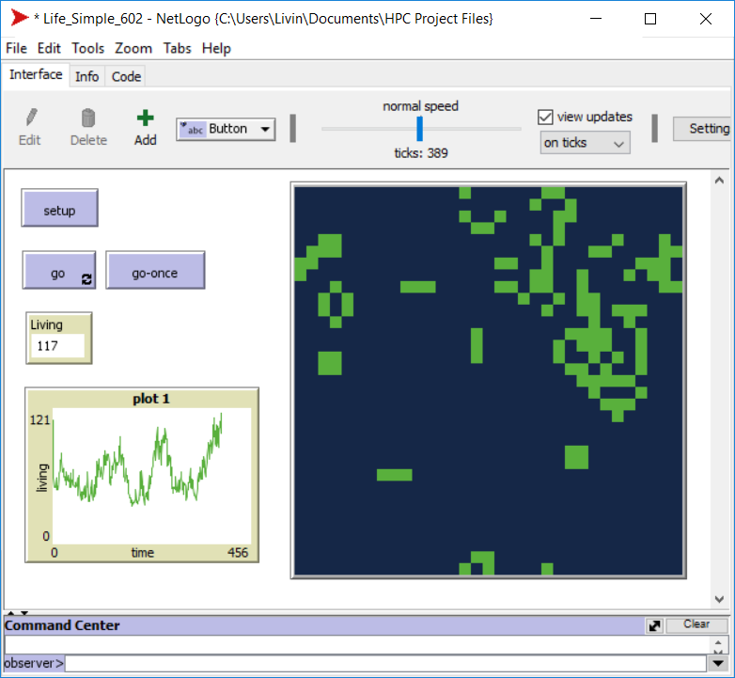
NetLogo: Description
Desktop application
Runs in Java (better for CPU)
Headless mode runs models without the GUI in command line
BehaviorSpace experiments automatically run in parallel if there are multiple CPU’s
Parameter sweeping, defined output file values and format
Model library includes numerous examples which can be modified

Slide 17
NetLogo: I/O Types
Input types:
NetLogo model file in Logo-style syntax
Initial and exit functions
Agent variables and functions
Code specifying buttons, switches, model parameters
XML-formatted experiment setups inside the model file
Can be created through the application’s UI or manually written
Output types:
Using headless mode: CSV spreadsheet or table showing specified output data from all iterations

Slide 18
NetLogo: On Agave
Interactive
Important commands:
interactive -p <PARTITION> -t <DS-HR:MN> -q <QOS>
Or just interactive
Optional: -n <cores> -N <nodes>
load netlogo/6.0.4 {Load NetLogo}
Most recent version that can be run on the cluster
NetLogo {Open the NetLogo}
Or use the headless commands
Sbatch script
Important lines:
#SBATCH lines (same details from interactive plus more)
load netlogo/6.0.4 {Load NetLogo 6.0.4}
NetLogo headless commands
sbatch <job script name>
Instructions can be more complex
Examples on NoMachine

Slide 19

FlameGPU: Description
On Visual Studio or Linux console (to use on Agave)
GPU-based
Parallelized CUDA code and executable created from user-written XML and C files
User does not need to know how to program in CUDA
Really fast
Console and visualization modes
2D and 3D models
Custom visualization
Has examples which can be copied and modified (recommended)

Slide 20
FLAMEGPU: I/O Types (P1)
Input: XML model file (XMLModelFile.xml)
Environment
Environmental constants
Function names
Optional graph data structures
Agents
Agent variables, functions, and states
Type: discrete (cellular automata) or continuous (3D or abstract)
Buffer size: max number of instances
Messages
Messages
(communication between agents)
Message name, variables, partitioning type, buffer size
Layers
Function dependencies

Slide 21
FLAMEGPU: I/O Types (P2)
Input: C function file (functions.c)
Global variables
Agent function definitions
Input: Initial states file (0.xml)
Define environmental constants from model file, initial config of agents
One per combination of inputs (no parameter sweeping)
Create a program to write one with random agents
Output: XML output files (<itno>.xml)
Same format as the initial states file
Every 1 or 5 iterations, or none
Need to parse to analyze data

Slide 22
FLAMEGPU: Setup steps
Create XMLModelFile.xml, functions.c, and a Makefile
Create visualization files if needed
Make sure the paths specified in the Makefile are correct
Best to copy one from one of the examples
python tools/new_example.py –base <Example> <NewExample>
Creates the necessary directories and files for model NewExample
Create an 0.xml
Write a separate program in your preferred scripting language for this purpose
Example: A script that takes in dimensions of a grid to create agents for a cellular automata. Agent traits will be randomly determined. Loops with print statements to a file.

Slide 23
FlameGPU: On Agave
Interactive
Important commands:
interactive –p <GPU partition> --gres=gpu:<Num of GPU’s> -t <DY-HR:MN> -q <QOS>
Sbatch script (recommended)
Important lines:
#SBATCH --gres=gpu:<Num of GPU’s>
#SBATCH -p <GPU partition>
#SBATCH -q <QOS>
#SBATCH -t <DAYS-HRS:MIN>
module load cuda/9.2.148 {load CUDA}
module load flamegpu/1.5.0
make clean {Makefile command}
FlameGPU console mode command:
make console {Makefile command}
<path to executable> <path to 0.xml> <num of iterations> 0 <output frequency>
CUDA device ID: keep as 0
Output frequency: 0, 1, or 5
Inputted paths can be long. Sbatch script with Bash variables recommended for this

Slide 24
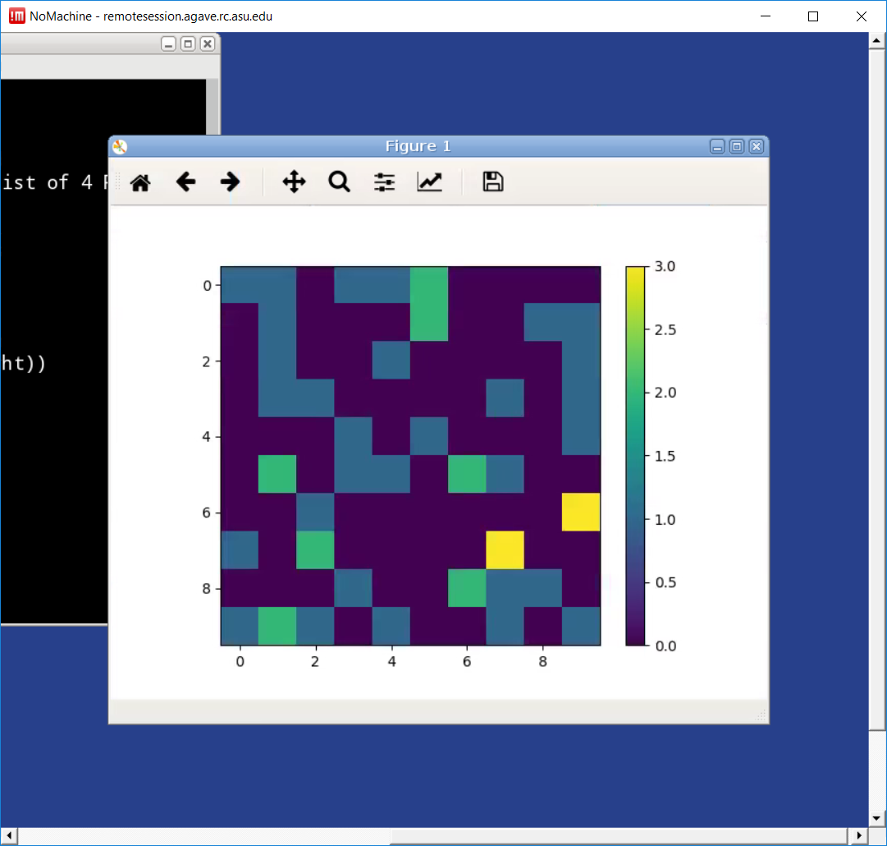
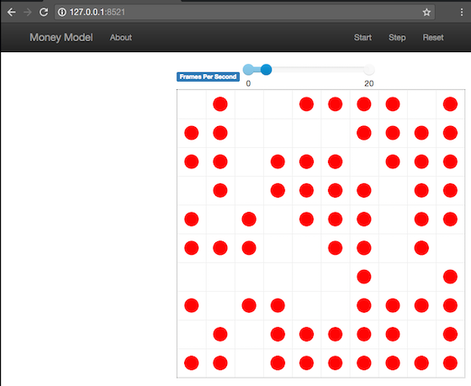
Mesa: Description
Meant to be the Python version of NetLogo
Can take advantage of Anaconda, panda frames, other helpful Python libraries
Outputting graphs/plots
Optimized for CPU
Running on GPU isn’t that much faster
Browser-based UI that looks/works very similar to NetLogo’s
Can program custom UI elements with JavaScript
Need to use NoMachine to see graphs/plots/UI if using a Windows machine
Haven’t seen 3D models yet
Batch running allowed

Slide 25
Mesa: I/O types
Input: Python Model file
Import Mesa’s Model class as a child class, and add agent-specific variables and functions
Model functions and a step function
Input: Python Agents file
Import Mesa’s Agent class as a child class, and add agent-specific variables and functions
Agent functions and a step function
Input: Python UI file (optional)
Usually named Server.py or <model>_Viz.py
Output: Python graphs/plots, pandas tools, etc

Slide 26
Mesa: Setup
Write the Python Agents and Model files
Import Mesa’s Model and Agent classes (inheritance), and add model-specific variables and functions
If using visualization, write a server.py or <model name>_Viz.py file
Runs the model but invokes UI stuff
Recommended: write a Python script that instantiates, runs, and collects data from the model
Operations can be more complex while being easy to manage change
Won’t have to type the same commands repeatedly in the Python console
Can simply call python <scriptname>.py in the sbatch script or in interactive mode

Slide 27
Mesa: On Agave
Interactive
Important commands:
interactive -p <PARTITION> -t <DAYS-HRS:MIN> -q <QOS>
Or just interactive
Sbatch script
Important lines:
#SBATCH lines
Same ones for a NetLogo model
module load python/3.7.1 {includes Mesa}
Load any other Python libraries you’d need
NumPy, Anaconda
In Python console or IPython: instantiate model, run it, and collect data
Or run a Python script with that code
Can’t use IPython
Have the sbatch script run a Python script that instantiates the model, iterates, collects data

Slide 28
Sources
https://www.anylogic.com/use-of-simulation/agent-based-modeling/
http://paulrichmond.shef.ac.uk/teaching/NVIDIA/rabat/FLAMEGPU_Tutorial.pdf
http://docs.flamegpu.com/en/master/flamegpu/introduction.html
https://ccl.northwestern.edu/netlogo/docs/

